Slide 1
Next Generation Deepwater Facilities
A View Forward Based on the Past by
Ken Arnold
K Arnold Consulting, Inc.

Slide 2
Outline
Understanding the Problem
Lessons from the Past
  Subsea
  Floater
  Topsides
  Project Management
Thoughts for a Way Forward

Slide 3
Making a Project Viable
It is not just lowering capital cost
  Operating cost
  Safety and Reliability
  Cash flow
Evaluating incremental increase in investment
  $200MM yields PVP $300MM
  $100MM yields PVP $275MM
Putting the facilities capital cost in perspective
  Facilities capital cost vs. PV cash flow from production
Are we spending too much time and money on facilities FEEDS?

Slide 4
What Do We Need?
New technology
Standardization
Proper use of old technology
Appropriate commercial plan of activity
Elimination of studies to prove the obvious
Make decisions
  Accept we don’t know everything we would like to know
  Simplicity in design
  Flexibility vs. process optimization
  Reduce focus on long term optimization
  Start small and rejoice in the upside if it happens

Slide 5
Outline
Understanding the Problem
Lessons from the Past
  Subsea
  Floater
  Topsides
  Project Management
Thoughts for a Way Forward

Slide 6
Shell Lockheed – 1960s
Task:
  Complete subsea wells in up to 1500 feet of water
  Manifold them and provide for testing
Problem:
  Capabilities of ROVs
  Instrumentation and controls reliability
  No multiphase flow meters
Solution:
  One atmosphere chambers with diving bell access
  Wellhead- 1972
  Manifold and test separator- 1975
Result:
  Successful program but wrong solution

Slide 7
Subsea Processing to Reduce Topside Weight
Task:
  Separate oil, water and gas subsea
  Dispose of water subsea
  Reduce flow assurance and transport costs
Problem:
  Treat the oil and dispose of water
  Treat or re-inject the gas
  Provide support and utilities to subsea
Results:
  Working the problem for 25 years
  Need to demonstrate long term operating, maintenance and reliability

Slide 8
Subsea Processing to Reduce Topside Weight (Continued)
Question: Do We Understand the Savings
Long tiebacks
  Hydrates, paraffins, asphaltenes
  Backpressure on wells
Do we Really Eliminate Topside Cost & Weights
  Analysis of 75,000 BOPD GOM topsides weight savings:
    Gas/Liquid Separation: 2.6%
    Bulk Oil/Water Separation: 2.5%
    Oil Treating: 8.0%
    Water Treating: 2.2%

Slide 9
Outline
Understanding the Problem
Lessons from the Past
  Subsea
  Floater
  Topsides
  Project Management
Thoughts for a Way Forward

Slide 10
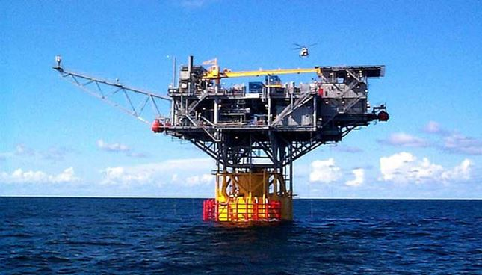
One GOM Operator
Business Model
  Develop marginal fields
  Minimal capital cost- Mini-TLP
Problem
  Fields others didn’t want
  Limited upside potential
  Reservoir risk
Results
  Reservoir problems
  Slight cost overruns
  Bankruptcy

Slide 11
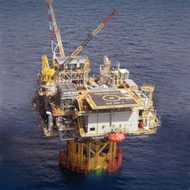
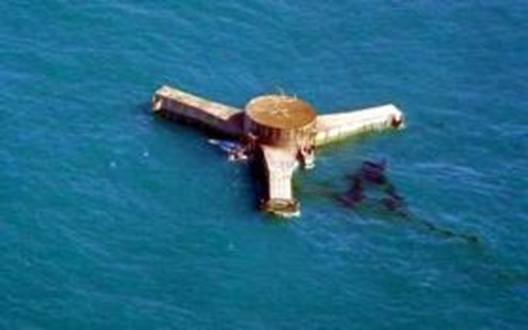
Typhoon

Slide 12
Considerations for Next Generation
Upside potential is important
Elegant solutions to reduce cost may introduce risk

Slide 13
Outline
Understanding the Problem
Lessons from the Past
  Subsea
  Floater
  Topsides
  Project Management
Thoughts for a Way Forward

Slide 14
Fit for Purpose
Four aspects cause cost differences:
  Commercial plan of execution
  Documentation required for project management
  Quality standards
  Design choices and complexity
Commercial plan of execution is often dictated by country
Documentation often dictated by regulatory regime and oil company policies
Quality standards alone have some impact but normally of the order of 10 to 25% of equipment cost (4 to 10% of topside cost)
Design choices and complexity have greatest impact

Slide 15
Standard Facilities
Shell, late 1960s
  Built 3 complete sets of standard modules for GOM 8-pile decks
  Installed one; heavily modified the other two
  Not practical
Natco, mid 1970s
  Built several standard 50 MMSCFD topsides for 4-pile decks
  Not a viable sales tool
Problem: There are no ASTM standard reservoirs

Slide 16
Shell Typical Facilities
Mid 1970s to Mid 1980s
No two reservoirs and fields are exactly alike
  It is not possible to design a standard facility
Facilities are made up almost entirely of similar building blocks
  It is possible to develop a set of fit for purpose quality specifications for 90+% of needs
  It is possible to develop a standard process for making overall design decisions
  It is possible to develop a set of unsized “typical facility”, fit for purpose building block P&IDs

Slide 17
Considerations for Next Generation
Advances in separation and treating equipment are helpful
An agreed industry design for a “standard” topside will probably not work
Individual companies could adopt “typical facilities” concepts

Slide 18
Outline
Understanding the Problem
Lessons from the Past
  Subsea
  Floater
  Topsides
  Project Management
Thoughts for a Way Forward

Slide 19
NS vs GOM PM Philosophies
Paragon 1989 OTC:
  60 to 120% increase due to design philosophy
1990 BP report by Davy McDermott:
  Controllable topsides premium 70%
UK Department of Trade and Industry 1999:
  Incorporating GOM practices can save roughly $100MM (~80% premium)
  GOM differs from NS in project execution and philosophy:
    Oil companies act as prime contractors
    Regulatory system requires less documentation
    Less instrument complexity
    Use of standard vendor packages with ancillary items
    Fewer safety studies
    HA based on experience captured in codes and judgment
    Specification and quality documentation
    Fewer man-hours for inspection, project auditing and control services
    More engineering consistency from job to job

Slide 20
GOM Topsides Independent vs. Major Oil Company 1999
48% Premuim
 | Independent | Major
BOPD | 60,000 | 60,000
MMSCFD | 200 | 120
BWPD | 75,000 | 30,000
Water Injection, BWPD | Future (90,000) | 72,000
Construction type | Skids | Integrated
Topside TIC | $64 MM | $145 MM
TIC adjusted for compression and waterflood | $64 MM | $95 MM

Slide 21
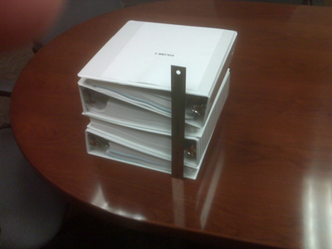
Company “X”
70 MMSCFD Glycol Dehy Bid Package
Bid package size:
  “X” GOM: 12-inches
  Paragon WA: 150 pages
  Independent GOM: 16 pages
Results:
  One bidder declined
  One bidder read specs and was 50% high
  Successful bidder applied company factor
  “Contract inspectors don’t know what is in there”
  43 to 63% higher cost than Paragon/Independent

Slide 22
Considerations for Next Generation
Large savings are possible based on project design philosophies and commercial plan of execution
Questions:
  Are we over-analyzing the design?
  Is all the documentation really adding value?
  What is the right level of instrumentation?
  Are all the safety studies really needed?
  Can “typical facilities” help with engineering consistency and removing complexity?

Slide 23
Outline
Understanding the Problem
Lessons from the Past
  Subsea
  Floater
  Topsides
  Project Management
Thoughts for a Way Forward

Slide 24
What Do We Need?
New technology
Standardization
Proper use of old technology
Appropriate commercial plan of activity
Elimination of studies to prove the obvious
Make decisions
  Accept we don’t know everything we would like to know
  Simplicity in design
  Flexibility vs. process optimization
  Reduce focus on long term optimization
  Start small and rejoice in the upside if it happens

